Slide 1
Design and Analysis of Algorithms
Algorithms-II : CS345A
Lecture 26
Network Flow – V
Polynomial time algorithms for Maximum Flow

Slide 2
Recap of the last lecture

Slide 3
Polynomial Time algorithms for max-flow
Algorithm 1 For Networks with integer capacities

Slide 4

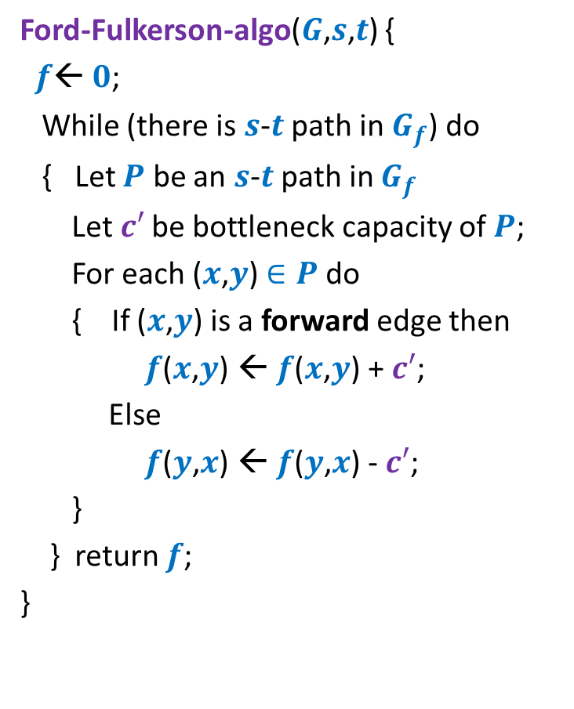

Algorithm 1
Algorithm-1($G$,$s$,$t$) {
Ford-Fulkerson-algo($G$,$s$,$t$) {
$f$← $0$;
While (there is $s$-$t$ path in $G_{f}$) do
{ Let $P$ be an $s$-$t$ path in $G_{f}$
Let$c′$ be bottleneck capacity of $P$;
For each ($x$,$y$) $∈P$ do
{ If ($x$,$y$) is a forward edge then
$f$($x$,$y$) ← $f$($x$,$y$) + $c′$;
Else
$f$($y$,$x$) ← $f$($y$,$x$) - $c′$;
}
} return $f$;
}
Let $P$ be the max-capacity $s$-$t$ path in $G_{f}$;

Slide 5
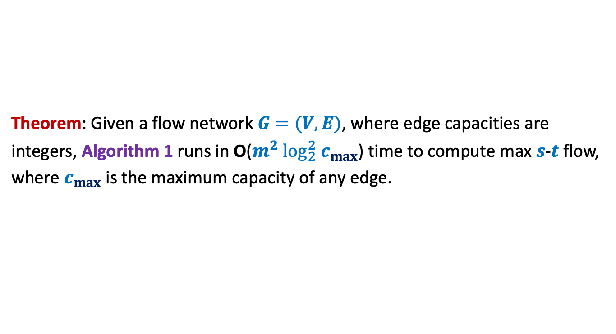
Algorithm 1
Theorem: Given a flow network $G=(V,E)$, where edge capacities are
integers, Algorithm 1 runs in O($m^{2} \log_{2}^{2} c_{max}$) time to compute max $s$-$t$ flow,
where $c_{max}$ is the maximum capacity of any edge.

Slide 6

Polynomial Time algorithm for max-flow
Algorithm 2
For Networks with edge capacities $∈R^{+}$

Slide 7
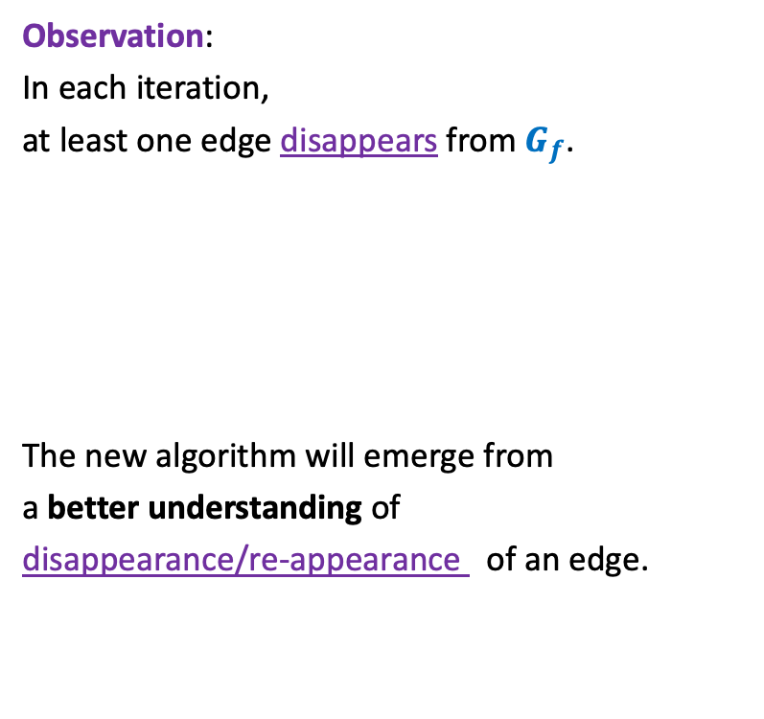

Ford Fulkerson Algorithm
Ford-Fulkerson-algo($G$,$s$,$t$) {
$f$← $0$;
While (there is $s$-$t$ path in $G_{f}$) do
{ Let $P$ be an $s$-$t$ path in $G_{f}$
Let$c′$ be bottleneck capacity of $P$;
For each ($x$,$y$) $∈P$ do
{ If ($x$,$y$) is a forward edge then
$f$($x$,$y$) ← $f$($x$,$y$) + $c′$;
Else
$f$($y$,$x$) ← $f$($y$,$x$) - $c′$;
}
} return $f$;
}
Observation:
In each iteration,
at least one edge disappears from $G_{f}$.
The new algorithm will emerge from
a better understanding of
disappearance/re-appearance of an edge.
But it may appear in $G_{f}$ again.

Slide 8

Edges in Residual Network $G_{f}$
Forward Edge
Any Edge
Backward Edge

Slide 9










Disappearance of an edge
➔ ($x$,$y$) must belong to the path $P$ selected during $i$th Iteration.
$$s$$
$$t$$
$$G_{f}$$
$$x$$
$$y$$
After $i$th Iteration
$$s$$
?
$$t$$
$$G_{f′}$$
$$x$$
$$y$$

Slide 10






(Re)-Appearance of an edge
➔ ($y$,$x$) must belong to the path $P$ selected during $i$th Iteration.
$$s$$
$$t$$
$$G_{f}$$
$$x$$
$$y$$
After $i$th Iteration
$$s$$
$$t$$
$$G_{f′}$$
$$x$$
$$y$$

Slide 11





Journey of an edge
$$P$$
$$G_{f}$$
$$s$$
$$t$$
$$x$$
$$y$$
After $i$th Iteration
$$s$$
$$t$$
$$x$$
$$y$$

Slide 12
Journey of an edge
$$P$$
$$G_{f}$$
$$s$$
$$t$$
$$x$$
$$y$$
After $i$th Iteration
$$s$$
$$t$$
$$x$$
$$y$$

Slide 13



Journey of an edge
$$P$$
$$G_{f}$$
$$s$$
$$t$$
$$x$$
$$y$$
After $i$th Iteration
$$s$$
$$t$$
$$x$$
$$y$$
$$P$$
$$G_{f′}$$
$$s$$
$$t$$
$$x$$
$$y$$
After $j$th Iteration
$$s$$
$$t$$
$$x$$
$$y$$

Slide 14




Algorithm 2
Ford-Fulkerson-algo($G$,$s$,$t$) {
$f$← $0$;
While (there is $s$-$t$ path in $G_{f}$) do
{ Let $P$ be an $s$-$t$ path in $G_{f}$
Let$c′$ be bottleneck capacity of $P$;
For each ($x$,$y$) $∈P$ do
{ If ($x$,$y$) is a forward edge then
$f$($x$,$y$) ← $f$($x$,$y$) + $c′$;
Else
$f$($y$,$x$) ← $f$($y$,$x$) - $c′$;
}
} return $f$;
}
Algorithm-2($G$,$s$,$t$) {
In each iteration, at least one edge
disappears from $G_{f}$.
➔
An edge can disappear and re-appear O($n$) times.
Let $P$ be the shortest $s$-$t$ path in $G_{f}$;
How to modify the FF algorithm so that the number of times an edge disappears during the algorithm has a polynomial bound ?
O($m^{2}n$) time

Slide 15

Algorithm 2
Ford-Fulkerson-algo($G$,$s$,$t$) {
$f$← $0$;
While (there is $s$-$t$ path in $G_{f}$) do
{ Let $P$ be an $s$-$t$ path in $G_{f}$
Let$c′$ be bottleneck capacity of $P$;
For each ($x$,$y$) $∈P$ do
{ If ($x$,$y$) is a forward edge then
$f$($x$,$y$) ← $f$($x$,$y$) + $c′$;
Else
$f$($y$,$x$) ← $f$($y$,$x$) - $c′$;
}
} return $f$;
}
Algorithm-2($G$,$s$,$t$) {
Let $P$ be the shortest $s$-$t$ path in $G_{f}$;
How to prove:
An edge can disappear and re-appear O($n$) times.

Slide 16







A crucial Insight
Lemma : Distance from $s$ to each vertex increases monotonically in $G_{f}$.
$$δ_{f′}\left(s,x\right)≥δ_{f}\left(s,x\right)$$
$$δ_{f}(s,x)$$
$$s$$
$$t$$
$$x$$
$$G_{f}$$
After $i$th Iteration
$$δ_{f′}(s,x)$$
$$s$$
$$t$$
$$G_{f′}$$
$$x$$

Slide 17


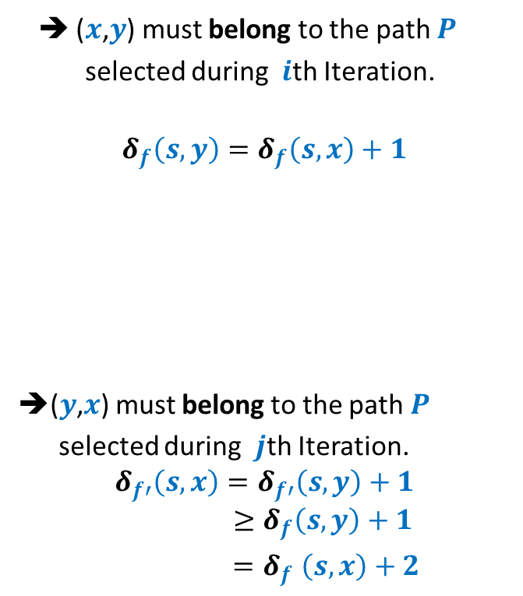



Bounding the disappearing/re-appearing of an edge
$$G_{f}$$
$$s$$
$$t$$
$$x$$
$$y$$
➔ ($x$,$y$) must belong to the path $P$
selected during $i$th Iteration.
$$δ_{f}\left(s,y\right)=δ_{f}\left(s,x\right)+1$$
➔($y$,$x$) must belong to the path $P$
selected during $j$th Iteration.
$$δ_{f′}\left(s,x\right)=δ_{f′}\left(s,y\right)+1$$
$$≥δ_{f}\left(s,y\right)+1$$
${=δ}_{f}\left(s,x\right)+2$
After $i$th Iteration
$$s$$
$$t$$
Using Lemma from the previous slide
$$x$$
$$y$$
$$δ_{f′}\left(s,y\right)≥δ_{f}\left(s,y\right)$$
$$G_{f′}$$
After $j$th Iteration
$$s$$
$$t$$
$$x$$
$$y$$

Slide 18
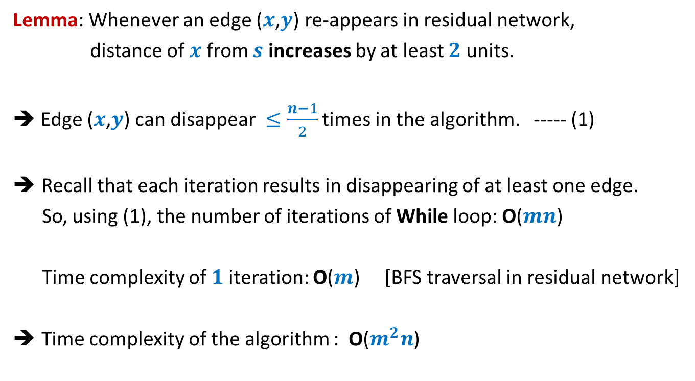
Analysis of Algorithm 2
Lemma: Whenever an edge ($x$,$y$) re-appears in residual network,
distance of $x$ from $s$ increases by at least $2$ units.
➔ Edge ($x$,$y$) can disappear $≤\frac{n−1}{2}$ times in the algorithm. ----- (1)
Recall that each iteration results in disappearing of at least one edge.
So, using (1), the number of iterations of While loop: O($mn$)
Time complexity of $1$iteration: O($m$) [BFS traversal in residual network]
Time complexity of the algorithm : O($m^{2}n$)

Slide 19
Proof of the monotonic increase of distanceS in residual network
Homework

Slide 20
Application # 1 of Max-Flow
Bipartite Matching

Slide 21
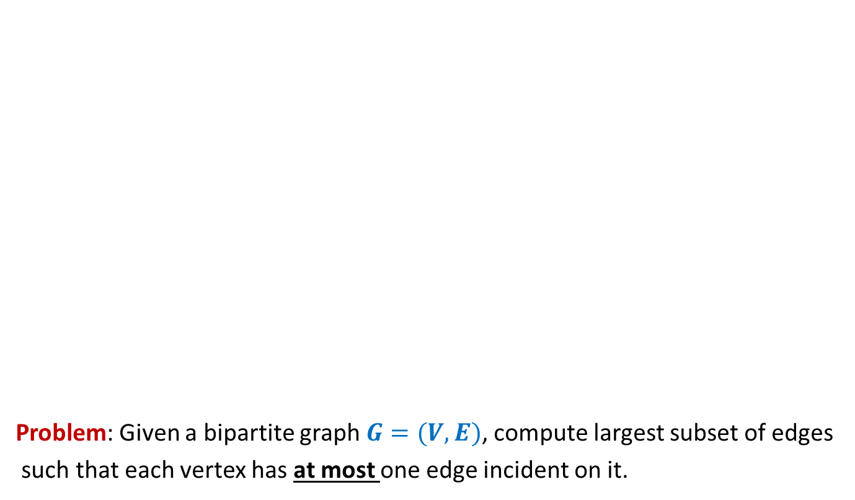
Bipartite matching
Problem: Given a bipartite graph $G=(V,E)$, compute largest subset of edges
such that each vertex has at most one edge incident on it.
applicants
jobs
Matching of size 5
Matching of size 3

Slide 22







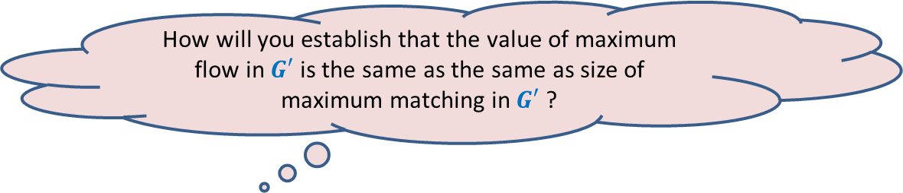
Bipartite matching Maximum Flow
How to extract the matching from the max-flow ?
How does the max-flow instance look like ?
applicants
jobs
$$1$$
$$1$$
$$1$$
$$1$$
$$1$$
$$1$$
$$1$$
Homework
$$1$$
$$G′$$
$$s$$
$$1$$
$$t$$
$$1$$
$$1$$
$$1$$
$$1$$
$$1$$
$$1$$
$$1$$
$$1$$
$$1$$
$$1$$
$$1$$
$$1$$
$$1$$
$$1$$
How will you establish that the value of maximum flow in $G′$ is the same as the same as size of maximum matching in $G′$ ?

Slide 23

Application # 2 of Max-Flow
Maximum no. of Edge Disjoint paths from $s$ to $t$

Slide 24
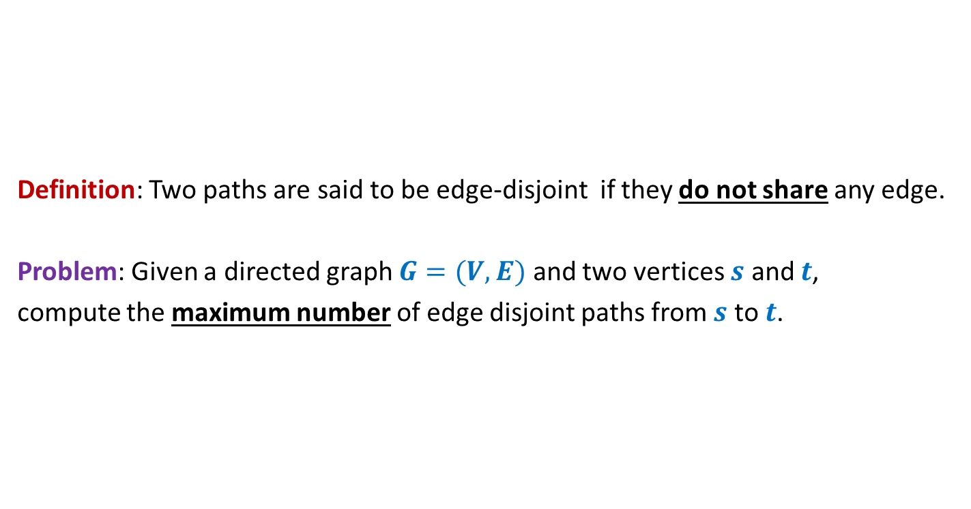

Maximum no. of Edge Disjoint paths from $s$ to $t$
Definition: Two paths are said to be edge-disjoint if they do not share any edge.
Problem: Given a directed graph $G=(V,E)$ and two vertices $s$ and $t$,
compute the maximum number of edge disjoint paths from $s$ to $t$.

Slide 25
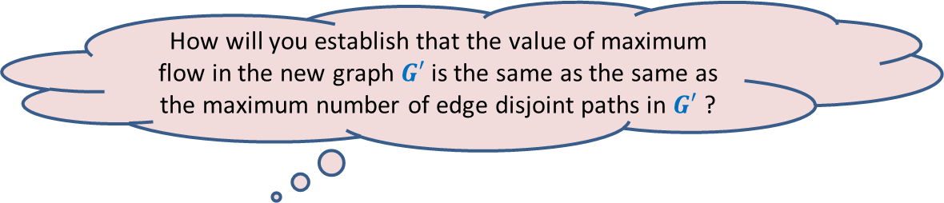



Maximum no. of Edge Disjoint paths from $s$ to $t$
$$G$$
$$s$$
$$t$$
Homework
How does the max-flow instance look like ?
How to extract the edge disjoint paths from the max-flow ?
How will you establish that the value of maximum flow in the new graph $G′$ is the same as the same as the maximum number of edge disjoint paths in $G′$ ?

Slide 26
Generalization of max-flow Problem
Extending the conservation constraint

Slide 27
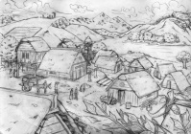
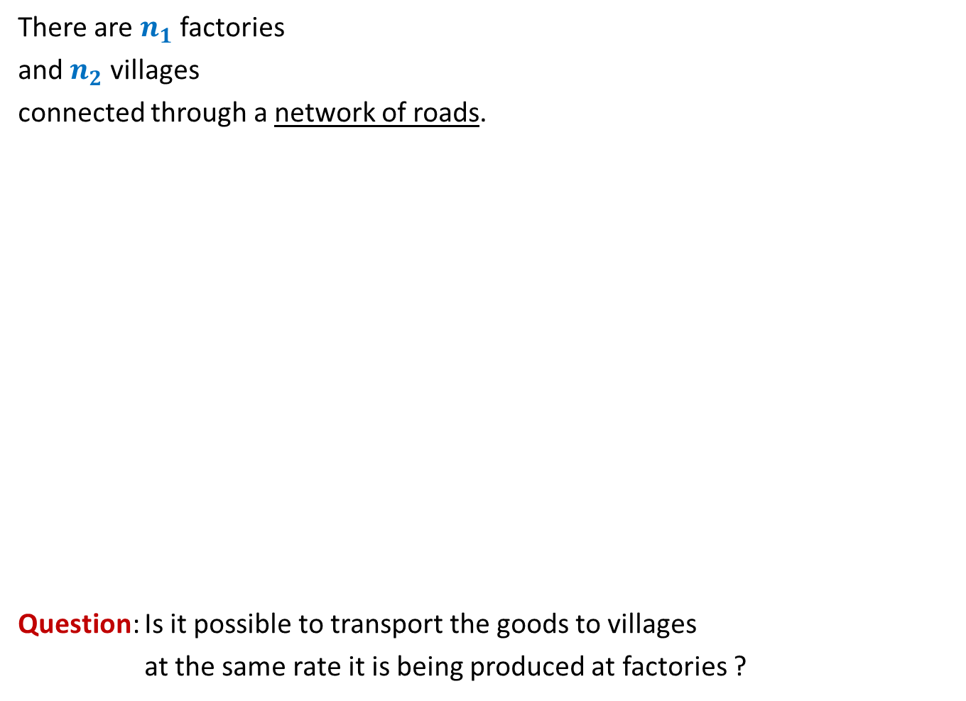
There are $n_{1}$ factories
and $n_{2}$ villages
connected through a network of roads.
Question: Is it possible to transport the goods to villages
at the same rate it is being produced at factories ?
600
400
300
No
Yes
What if roads have capacities ?
200
200
200
500

Slide 28
600
800
500
400
900
300
200
No
?
100
600
What if roads have capacities ?
200
700
200
700
300
50
200
500

Slide 29
We shall discuss these problems in the next lecture.
You are strongly advised to do the homework given in the class.

